Slide 1
Presentation Guidance – DO NOT PRESENT
Please include:
Intended presentation length
Intended audience: Data stewards, developers and administrators responsible for securing and governing their organization’s data lakes.
How seller should use the deck
Link to Wisdom page, SFDC campaign code (if you’re creating one)
Link to other decks with additional product slides, customer refs, industry reference architectures
Notes:
Include:
Intended presentation length: ~30-45 mins
Intended audience: Data stewards, developers and administrators responsible for securing and governing their organization’s data lakes
How seller should modify the deck: Tailor to the audience based on their level of knowledge of Lake Formation, Data Lakes, and other AWS products.
Link to Mindtickle training on how to present the deck: TBD
Link to Wisdom page
Link to other decks with additional product slides, customer refs, industry reference architectures

Slide 2
Discover, prepare, and integrate all your data with AWS Glue
Contact Info

Slide 3

Agenda
Challenges
Why AWS Glue?
Use cases
Key customer case studies
How to get started
Q&A
Notes:
We will be addressing a series of topics today:
Common challenges when building data lakes or building a data mesh
An overview of AWS Lake Formation
A review of some key customer case studies
Open discussion of any questions you may have

Slide 4
Put data
to work
Make better decisions
Improve efficiencies
Respond faster
Uncover opportunities
Notes:
1/Companies need a data strategy that enables them to put their vast amounts of data to work to make better, more informed decisions, respond faster to the unexpected, look around corners, improve efficiencies, and uncover new opportunities.

Slide 5
Customers want more value from their data
Growing
exponentially
From new sources
Increasingly diverse
Used by many people
Analyzed by many applications
Notes:
1/Data volumes are increasing at an unprecedented rate, exploding from terabytes to petabytes and sometimes exabytes of data. Traditional on-premises data analytics approaches can’t handle these data volumes because they don’t scale well enough and are too expensive.
2/We hear from companies all the time that they are looking to extract more value from their data but struggle to capture, store, and analyze all the data generated by today’s modern and digital businesses. Data is growing exponentially. It’s coming from new sources, is increasingly diverse, and needs to be securely accessed and analyzed by any number of applications and people.

Slide 6







More demanding workloads
Batch
Real-time
Data warehousing
Business intelligence
Responsive dashboards
Monitor and alert
Streaming apps
Reporting
Nightly or hourly ETL
Latency-agnostic, long-running jobs
Continuous operation
Latency-sensitive micro-batch jobs

Slide 7




Traditional ETL solutions can’t handle demands
Require multiple solutions
Non-scalable infrastructure
High
cost
Unique user skill sets
Multiple solutions are needed to get the job done
On-premise ETL tools are complex to install, manage, and scale
Advanced features - like centralized data catalog, handling streaming data - are licensed separately
Users have varying technical abilities to interact with data

Slide 8
Introducing AWS Glue

Slide 9





Execute modern data strategies (e.g. data lakes, data fabric) for scalable data analysis
Migrate from expensive traditional ETL solutions to gain flexibility and reduce costs
How customers use AWS Glue
Catalog data assets to make them available across a modern data architecture
Process petabytes of data in batch, streaming, and real-time using Python and Apache Spark
Prepare data for analytics and Machine Learning
Notes:
Customers use Glue to modernize their data platforms by moving off of legacy tools and to use purpose-built storage and compute for their data analysis, reducing their time and cost to value.
They adopt the Glue Data Catalog for its comprehensive integrations and automation, which gives them the flexibility to use the right tool for the job in their analytics stack.
Glue also lets them consolidate complex data architectures using a single tool that handles small and large scale seamlessly as well as batch and streaming workloads.
Finally, they adopt glue because it simplifies the process of preparing data for complex machine learning training and inference workloads.
Transition: The first example of this is iBotta

Slide 10

All-in-one data integration service
AWS Glue
Cost effective, serverless, and scalable
Discover, prepare, and integrate all your data at any scale
Tailored tools to support all data users
Support all workloads in one place
Notes:
AWS Glue is AWS’ data integration service.
When we launched Glue in 2017, we knew customers needed a scalable, serverless tool that addressed their ETL needs in one place. Since then, we’ve expanded to be a full-fledged Data Integration service for many kinds of users and every data preparation workload.
Glue simplifies complex, manual, and expensive traditional data integration processes and it supports the increased data volumes and data diversity encountered by customers in recent years. It scales automatically, and has pay-as-you-go billing to increase agility and optimize costs.
Glue supports users with varying technical skill sets with has integration interfaces and job-authoring tools that are easy to use for all user types, from developer to business user.
Transition: Let’s dive deeper into Glue’s functionality.

Slide 11
Break down data silos
Extract, transform, load
Visual data preparation
Data replication
Data warehouse to/from data lake
Federated query
Notes:
1/AWS Glue is a serverless data integration service that makes it easy to prepare data for analytics, machine learning, and application development. AWS Glue provides all of the capabilities needed for data integration, so you can gain insights and put your data to use in minutes instead of months.
2/Traditional data integration is a complex and iterative process that involves multiple tasks such as extracting data from various sources; enriching, cleaning, normalizing, and combining data; and loading and organizing data in databases, data warehouses, and data lakes. These tasks are often handled by different types of users that each use different products.
3/AWS Glue provides both visual and code-based interfaces to make data integration easy. Users can easily find and access data via the AWS Glue Data Catalog. Data engineers and ETL (extract, transform, and load) developers can visually create, run, and monitor ETL workflows with a few clicks in AWS Glue Studio. Data analysts and data scientists can use AWS Glue DataBrew to visually enrich, clean, and normalize data without writing code.

Slide 12

AWS Glue: Key Capabilities
Serverless data integration service
Scalable Data Integration Engine
Centralized and Unified Data Governance
Connect and Ingest Data
User Productivity and Data Ops
Built-in data transforms
Glue Data Catalog
Glue connectors
Persona specific tools
Glue Data Quality
Execution engine
Glue connector marketplace
Productivity tools
Monitor
Glue crawlers
Lake Formation
Variety of interfaces
Data ops tools
Notes:
TRANSITION:

Slide 13
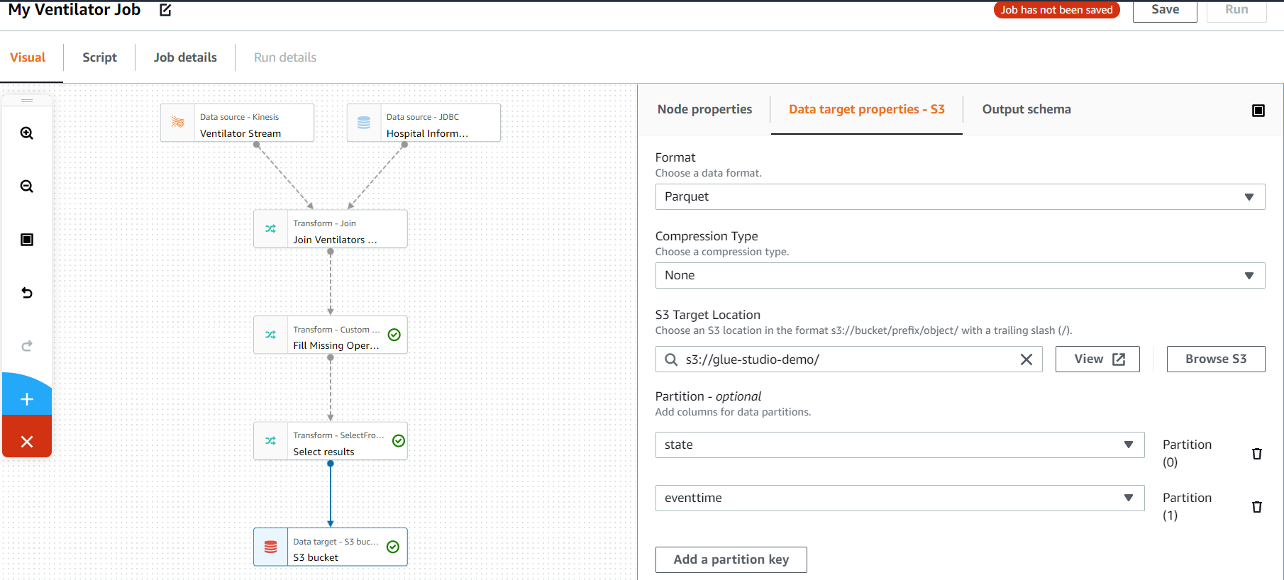
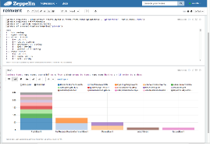
Designed for all data users
Business Analyst
Data scientist
Data engineer
ETL developer
AWS Glue Studio
AWS Glue DataBrew
AWS Glue Notebooks
Rich visual interface
Run ETL jobs without writing code
Clean and normalize data with a rich visual interface
250+ built-in transformations
Monitor thousands of jobs through a single pane of glass
Choose from 250+ built-in transformations to automate tasks
Profile data to understand data patterns and anomalies
Distributed processing
Profile data to understand data patterns and anomalies
Work on large datasets at scale
Advanced transforms though code snippets
Notes:
1/AWS Glue Studio is a new visual interface for AWS Glue that makes it easy for extract-transform-and-load (ETL) developers to author, run, and monitor AWS Glue ETL jobs.
2/You can now use a simple visual interface to compose jobs that move and transform data and run them on AWS Glue. You can then use AWS Glue Studio’s job run dashboard to monitor ETL execution and ensure that your jobs are operating as intended.
3/AWS Glue Studio makes ETL accessible to the many users who are new to Apache Spark programming and to users who are accustomed to ETL tools with boxes-and-arrows interfaces. Without writing code, users of all experience levels can now take advantage of big data processing on AWS Glue’s serverless Apache Spark-based ETL platform.
4/They can also use the AWS Glue Studio job monitoring dashboard to get a global view of their ETL execution and resource usage.
5/Over the last 20 years, the users for data analytics have grown as a result of a surge in the variety and volume of data that companies can collect. To prepare data for analytics or machine learning projects, data scientists and analysts have to either use spreadsheets to explore and experiment with data, or rely on data engineers and ETL developers to transform data into the required format. This often delays the process for weeks or months, as customers can spend up to 80% of their time in data preparation tasks rather than actually analyzing the data.
6/AWS Glue DataBrew makes it easy for data scientists and data analysts to clean and normalize data using a visual interface, reducing the time it takes to prepare data by up to 80%. With Glue DataBrew, you can visualize, clean, and normalize data directly from your data lake, data warehouses, and databases. You can choose from over 250 built-in transformations to automate data cleaning and normalization tasks, and save these transformation steps so they’re applied to new data as it comes in. You can evaluate the quality of your data by profiling it to understand data patterns and detect anomalies, all without writing a single line of code.
7/As part of AWS Glue, Glue DataBrew is serverless so you don’t need to manage the infrastructure. You pay only for what you use, with no upfront commitment. You can check out the Glue DataBrew page on the AWS website today, and learn more from our re:Invent session “Zero-code data preparation with AWS Glue DataBrew”.
TRANSITION: Let’s take a closer look with a demo of AWS Glue DataBrew.

Slide 14




Complete data integration capabilities in one place
Stream
Processing
Batch
Processing
Event
Processing
Easily integrate with Amazon MSK, Amazon Kinesis, and Apache Kafka
Combine, enrich, and transform data using Glue Studio
Adapt to varied and changing schemas

Slide 15
Data integration engines options
AWS Glue for Apache
Spark
AWS Glue for
Ray
(Preview)
AWS Glue for Python Shell
AWS Glue
Flexible Execution
~ 5 sec start-up
Performance- optimized Spark
Spark 3.3.0
Native data lake frameworks, Hudi, Iceberg, Delta Lake
Serverless Ray.io
Scale existing Python code on large datasets
Use familiar Python libraries
2x faster start times
Dozens of pre-loaded libraries
Python 3.10
Save up to 35% on non-urgent workloads
Ideal for one-time data loads or non-urgent SLAs
Notes:
AWS Glue offers multiple data integration engines to support all of your users and workloads. AWS Glue makes it easy to use the best engine for any workload, based on the characteristics of your workload and the preferences of your developers and analysts.
AWS Glue with Apache Spark
AWS Glue provides a performance-optimized, serverless infrastructure for running Apache Spark for data integration and ETL (extract, transform, and load) jobs. AWS Glue with Apache Spark supports batch and stream processing, and speeds up data ingestion, processing, and integration allowing you to hydrate your data lake and extract insights from data quicker.
AWS Glue with Ray (Preview)
AWS Glue with Ray makes it easy to scale Python code to process large scale data in AWS Glue. AWS Glue with Ray lets data analysts and engineers run their existing Python code at scale with pay-as-you go pricing. It simplifies and streamlines your ability to use Ray.io, an open-source unified compute framework that makes it easy to scale AI and Python workloads. Ray offers a simple programming model, and AWS Glue with Ray includes Ray-enabled versions of popular Python data processing libraries that you already use.
AWS Glue with Python Shell
AWS Glue with Python Shell lets you use a Python Shell job to run Python scripts as a shell in AWS Glue. These jobs allow you to write complex data integration and analytics jobs in pure Python. AWS Glue with Python Shell jobs now offer 19+ common analytics libraries out of the box, including Pandas, NumPy, and AWS Data Wrangler. You can use the bundled functionality to connect to a variety of databases, data warehouses, and AWS services.
AWS Glue Flexible Execution
AWS Glue Flexible Job Execution lets ETL development teams choose the right-sized execution class for the right job.
1/ Flexible Job Execution is ideal for workloads that aren’t time sensitive. It’s simple to set-up- you just simply change the default setting of the execution-class from
Standard (our fast and dedicated class) to “flexible.” Glue then monitors the available spare capacity in AWS and starts the job when it can acquire the needed capacity.
2/ It’s much more cost-effective than our time-sensitive standard execution class. In fact, when using AWS Glue Flexible Job Execution, you can save up to 35% on pre-production, test, and non-urgent data integration workloads.
3/This makes it easier to manage and reduce data integration spend when workloads aren’t time-sensitive. And, regardless of the execution-class you choose, all Glue jobs have the same capabilities, including access to custom connectors, zero-code job definition, automatic schema detection, and job scheduling.
4/ And, as always with AWS Glue, the service is serverless, so there’s no infrastructure to build, scale, or manage.

Slide 16


BMW powers self-service Cloud HUB data platform with AWS Glue
Challenge
BMW’s on-premises Hadoop platform for data ingestion and processing was hard-to-scale platform, leading to attrition of internal customers . They relied on DevOps to constantly provision clusters, and tuning was time-consuming. They also lacked self-service options for data ingestion led to longer data ingestion cycles
Solution
BMW built a self-service cloud hub platform and used AWS Glue for structured data ingestion. They created self-service features with a customized UI, and used Glue APIs to automatically provision AWS Glue jobs for data ingestion. They also built a customized level data catalog on top of AWS Glue Catalog and Catalog APIs
Result
Significant adoption of the Cloud HUB data platform with internal users
Users self-serve data instead of relying on data engineers, shortening data ingestion cycles
Notes:
Shorter / punchier – outcome
Andy
Quantify adoption + More detail in solution

Slide 17
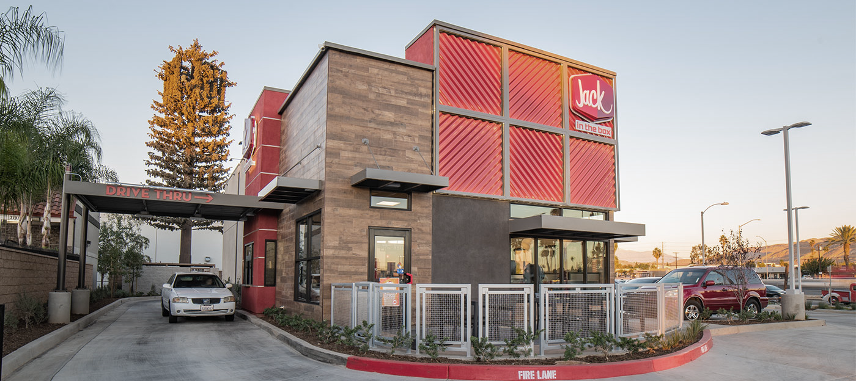
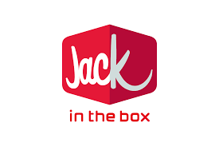

Jack in the Box improves performance and reduces costs with AWS Glue
Challenge
Jack in the Box’ s data platform built on Oracle, SQL server had high license costs, and those costs increased as data volumes increased. The proliferation of on-premises ETL tools like Informatica and SSIS led to an unmanageable codebase.
Solution
Jack in the Box centralized data pipelines to AWS Glue in phases.
Result
Reduced baseline software and hosting costs by 50%
Improved performance, scalability, and ability to focus on business problems rather than infrastructure challenges
Notes:
Jack in the Box Inc. (NASDAQ: JACK), based in San Diego, is a restaurant company that operates and franchises Jack in the Box® restaurants, one of the nation’s largest hamburger chains. Jack in the Box opened its first restaurant in 1951, and has since become one of the nation’s largest hamburger chains. At of the end of their fiscal year on October 1, 2017, the Jack in the Box system included 2,251 restaurants in 21 states and Guam, of which 276 were company-operated and 1,975 were franchise-operated. Jack in the Box revenues were $1.5Billion in 2017.
JITB Applications built on Oracle and SQL had complex data integration challenges. Data sizes were expected to increase rapidly, and JITB was forced with the challenge of keeping-up with performance requirements. Additionally, managing baseline software and hosting costs, and maintenance, was becoming a huge challenge. Additionally, JITB needed to keep track of an expanding set of external vendor data (SSRS, SSIS, Informatica, Pre processors, Oracle, SQL, Service Bus, OBIEE, etc.), which created a challenging master data issue. JITB also needed to improve the Franchisee's UX for standard/operational reporting, while also empowering JITB analysts with easy ad hoc & advanced analytics tools, to track sales and food/labor costs.
To meet these challenges, JITB made four major infrastructure decisions to: 1) Migrate from Microsoft SQL Server/ Oracle to Redshift, 2) Leverage Glue to transform their ETL load, 3) Use Lambda for all their file processing, and 4) Move to Tableau for a visualization tool for their franchisee and performance data.
Moving to Redshift significantly improved dashboard query performance. JITB ran a test on their current database vs. Redshift cluster before building any aggregates. Redshift performed ~200% faster than SQL Server/Oracle. JITB could easily test the cost/benefit tradeoffs by simply adding additional processing capacity when needed and building additional aggregates take less time, which took time and significant labor to build and complete. These changes enabled JITB to cut their baseline software and hosting costs in half, while improving their flexibility, performance and scalability. Most importantly, they have set up the capabilities they need to dramatically grow their
business while staying focused on their core business value.

Slide 18


ENGIE builds Common Data Hub on AWS, accelerates zero-carbon transition
Challenge
ENGIE’s decentralized global customer base had accumulated lots of data, and it required a smarter, unique approach and solution to align its initiatives and to efficiently provide data across its global business units.
Solution
ENGIE built its Common Data Hub data lake on AWS, enabling the company’s business units to collect and analyze data to support a data-driven strategy and to lead the zero-carbon transition.
Result
Collected 95 TB of data across 351 projects
Automated energy predictions
Maximized wind farm energy production
Amazon Kinesis Data Streams
Amazon Redshift
AWS Glue
Amazon Athena
Amazon S3
Amazon SageMaker
Notes:
ENGIE is a global energy company with 25 business units operating worldwide. The company powers millions of customers and develops integrated solutions throughout the value chain to support corporations’ and local authorities’ zero-carbon transition.
Case Study: https://aws.amazon.com/solutions/case-studies/engie-aws-analytics-case-study/
Challenge: ENGIE—one of the largest utility providers in France and a global player in the zero-carbon energy transition—produces, transports, and deals electricity, gas, and energy services. With 160,000 employees worldwide, ENGIE is a decentralized organization and operates 25 business units with a high level of delegation and empowerment. ENGIE’s decentralized global customer base had accumulated lots of data, and it required a smarter, unique approach and solution to align its initiatives and provide data that is ingestible, organizable, governable, sharable, and actionable across its global business units.
Solution: In 2018, ENGIE decided to accelerate its digital transformation through data and innovation by becoming a data-driven company. First, ENGIE wanted to build an enterprise data repository named the Common Data Hub to align its customers and business units around the same solution. The Common Data Hub helped ENGIE’s business units easily ingest, store, share, and consume datasets through a unified platform and highly secured environment, ultimately enabling the company to increase productivity, make accurate energy-production predictions, and bring new services to customers.
ENGIE used AWS to create the Common Data Hub, a custom solution built using a globally distributed data lake and analytics solutions on AWS. The Common Data Hub empowers teams to innovate by simplifying data access and delivering a comprehensive set of analytics tools. AWS Professional Services supported ENGIE in designing and implementing the solution and putting in place an internal service team (called the data@ENGIE team) that is in charge of evolving and operating the Common Data Hub platform.
The Common Data Hub was built using Amazon S3, an object storage service that offers industry-leading scalability, data availability, security, and performance. The solution also uses Amazon Redshift, a fully managed, petabyte-scale data warehouse service in the cloud that can query semistructured data in the Amazon S3 data lake, demonstrating the Modern Dataapproach to data warehousing.
Because the solution uses Amazon Redshift, customers can deploy data warehouses securely in their Common Data Hub environments and make use of analytics. The company’s business unit administrators, by managing Amazon Redshift clusters on the Common Data Hub, can be added to Common Data Hub projects and easily access datasets in the Amazon S3 data lake, as well as build valuable insights from the Common Data Hub’s rich datasets catalog. The Common Data Hub uses Amazon Redshift for two different types of data access. It uses Amazon Redshift Spectrum for direct query to the Common Data Hub’s S3 buckets and uses Amazon Redshift as a provisioned data warehouse with its own internal storage.
Other AWS services involved in the Common Data Hub include Amazon Kinesis Data Streams (Amazon KDS), a massively scalable and durable real-time data streaming service. Using Amazon KDS enables ENGIE to easily collect, process, and analyze streaming data from Internet of Things devices in real time, meaning ENGIE can quickly gather the information it uses to develop insights. AWS Glue—a fully managed extract, load, transform (ETL) service for a metadata repository—further helps transfer and clean the data. Amazon Athena, an interactive query service that makes it easy to analyze data in Amazon S3 using standard SQL, lets ENGIE business units view data. And to glean further insights from data, ENGIE relies on Amazon SageMaker, a fully managed service that provides every developer and data scientist with the ability to build, train, and deploy machine learning models quickly.
Result:
ENGIE discovered significant value by using AWS services to build its Common Data Hub, enabling its global business units to collect, share, and analyze data in more productive ways. ENGIE’s business units still retain autonomy, but they can now benefit from the strengths of centralized data, garnering important insights from similar use cases as they discover newer, more efficient ways to power the world.
Benefits:
Collected 95 TB of data across 351 projects
Automated energy predictions
Increased business unit productivity
Maximized wind farm energy production

Slide 19


Want to build a data vision and strategy?
Have a strategy and need help executing it?
data-driven everything
Joint engagements with business and technology stakeholder alignment
Joint engineering engagements between customers and AWS technical resources
Create an organizational vision for innovation with data to drive business outcomes
Create tangible deliverables to accelerate strategic databases, analytics, and ML initiatives
Define the first pilot, learn, and build
Leave with an architecture, working prototype, path to production, and deeper knowledge of AWS services
Jumpstart the data flywheel
Come with an idea, leave with a solution
Notes:
1/Do you want to build a data vision and strategy? AWS Data-Driven EVERYTHING program (D2E), AWS will partner with our customers to move faster, with greater precision and far more ambitious scope to jumpstart your own data flywheel.
2/Historically, customers have struggled with their database and analytics transformation and often face challenges such as:
Lack of clarity on what “great looks like”
Difficulty identifying and prioritizing their use-cases
Complex business cases traditionally under delivered
Skill gaps to build advanced capabilities
Data privacy, security, compliance, and governance requirements
Legacy investments and technical debt
Significant undifferentiated, heavy lifting to support complex on-premise environments
3/In order to harness data for improved business outcomes, organizations must establish new data strategies and rationalize platforms, technologies and approaches. D2E partners AWS experts with stakeholders across business and technology to accelerate the journey to becoming data-driven using this two-phase program to mobilize around a specific use case, create a pilot and then scale that pilot into production with robust security, operations and a well-defined organizational strategy.
4/Do you have an existing strategy, but need help executing it? Consider the AWS Data Lab. AWS Data Lab offers accelerated, joint engineering engagements between customers and AWS technical resources to create tangible deliverables that accelerate data and analytics modernization initiatives. 5/The Data Lab program has two offerings - the Build Lab and the Design Lab. The Build Lab is a two to five day intensive build with a technical customer team. The Design Lab is a one-half to two day engagement for customers who need a real-world architecture recommendation based on AWS expertise, but are not yet ready to build. All AWS Data Lab engagements are hosted either online or at one of our five in-person AWS Data Lab hubs (Seattle-WA, New York-NY, Herndon-VA, London-UK, Bangalore-IN).
6/During the lab, AWS Data Lab Solutions Architects and AWS service experts support the customer by providing prescriptive architectural guidance, sharing best practices, and removing technical roadblocks. Customers leave the engagement with an architecture or working prototype that is custom fit to their needs, a path to production, deeper knowledge of AWS Databases, Analytics, and Machine Learning services, and new relationships with AWS service experts.
7/You’ll also find further resources for both programs in the resource tab of this video player.

Slide 20
Questions?

Slide 22
Appendix

Slide 23
PREVIEW
Automatic data quality rule recommendations based on your data
Data quality for datasets in your data lake and data pipelines
Cost-effective to scale with pay-as-you-go billing, with no lock-in
AWS Glue
Data Quality
Deliver high quality data across your data lakes and data pipelines
Notes:
Python tops the charts as the world’s most popular programming language. Developers love Python because it is easy to use and it has a rich collection of built-in code libraries, including Pandas for data manipulation, NumPy for mathematics, and Scikit-learn for machine learning that reduce the need to write code from scratch.
But, Python is hard to scale. Data analysts and engineers often struggle to scale Python jobs to operate on thousands of disparate files at once or on large datasets. . AWS Glue with Ray is a new option for running Python code in AWS Glue that makes it easy for data analysts and engineers scale their existing native Python code to process data at any scale. It’s a serverless deployment of a new open source framework for distributing Python, called Ray. Ray automates the work of scaling Python code. It can auto scale in seconds based on the load.
Users can seamlessly load existing Python code to Glue Studio, and rapidly execute that code on data at scale. Because AWS Glue is serverless – AWS Glue with Ray can auto scale on-demand…and you never need to configure or tune any resources. And, like all Glue capabilities, you pay only for the resources you use while running code.
AWS Glue with Ray includes Ray-enabled versions of the popular Python data processing libraries that you already use. It also integrates with other AWS services to simplify secure access to data in data lakes, data warehouses, and traditional data stores.

Slide 24





Preview
Serverless, scalable and performant
Data Quality Recommendations
Out-of-the-box data quality rules and actions
AWS Glue Data Quality Features and Benefits
Data Quality Definition Language
Data Quality for data-at-rest and data-in-transit
Supports multiple persona
Notes:
First, there is no infrastructure to maintain. You don’t need to worry about scalability because AWS Glue Data Quality uses the serverless infrastructure that runs over 800K jobs a day. You get the benefits of autoscaling out of the box. AWS Glue Data Quality is powered by DeeQu, tested at scale by Amazon teams to manage quality of 60 PB data lakes.
A challenge we talked about is that Data Engineers and Data Stewards need to manually profile the data. With AWS glue Data Quality, you can get your rules recommended back to you in minutes instead of manually creating them.
After you get the recommendations, you can tweak them using out-of-the-box data quality rules and associate out-of-box actions to take when quality deteriorates. Business users can’t write them because you might have to write them in JSON. Wizard based approach works
It is really hard to write data quality rules because most of them are in proprietary languages. To solve this, we created – DQDL (Data Quality Definition Language). This is a Declarative open language that allows users to simplify rule authoring, promotes reuse across datasets and is easy to deploy to higher environments.
Like we discussed before, many tools either focus on DQ at rest or DQ in data pipelines. You told us that your requirements are to have them in your workflow. So, we made Glue Data quality in a way where you can setup anywhere in your data integration workflow
Finally, we know that data engineers and data stewards care equally about data quality. So, we placed data quality on their workflow and created user experiences that appeals to them. For example, data stewards can work on the data catalog without worrying about the complexity of the data pipelines or Glue jobs. Whereas, data engineers can easily integrate integrate DQ in their data pipelines with the familiar APIs.
Lead in – so how does Glue Data Quality Work?

Slide 25





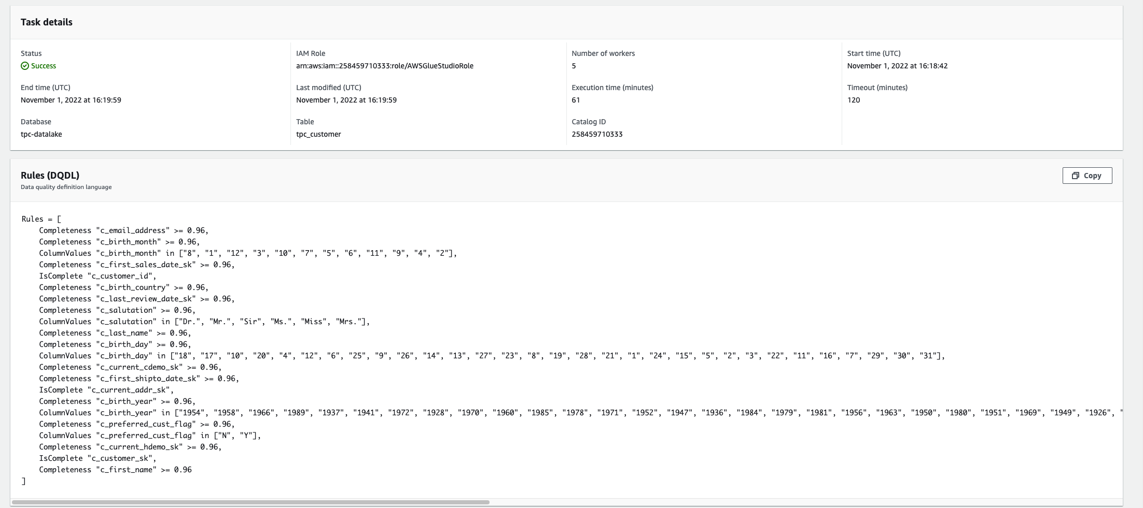
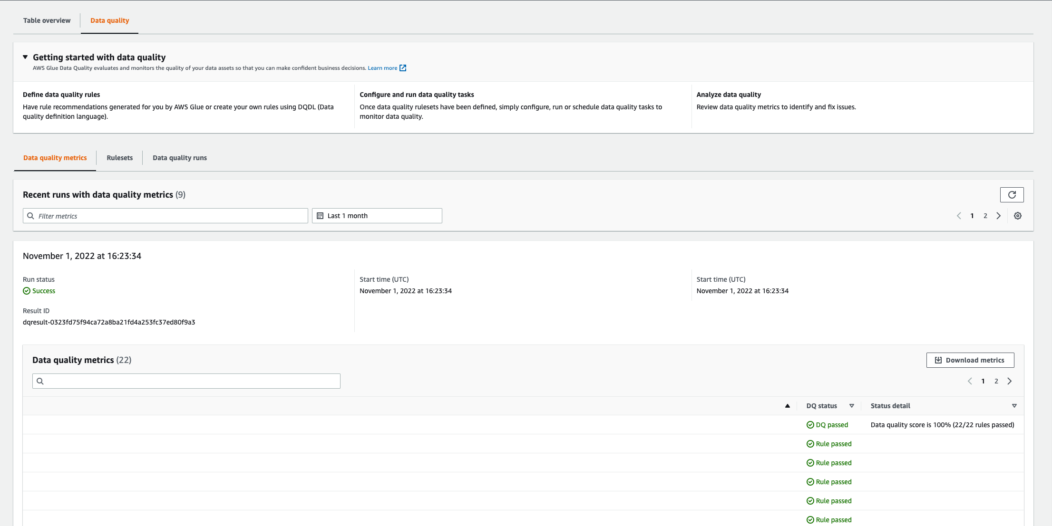
How it works: Data Quality on AWS Glue Data Catalog
Preview
Data Steward
Selects a dataset in AWS Glue Data Catalog
AWS Glue Data Quality analyzes data and recommends rules
Data Steward refines the rules to create finalized rules
AWS Glue Data Quality Evaluates rules
Data Steward reviews results and alerts, takes appropriate action
Notes:
If you are a data steward or a data Engineer, you can go to AWS Glue Data Catalog, select a dataset and then click on AWS Glue Data Quality. You can then click on recommendation button. Once you do this, we provide you a starting point for you to work on. You can add new rules, modify existing ones and delete ones you don’t want to. Then you save these rules and execute them. You can view the results in the Data Quality Results page.

Slide 26
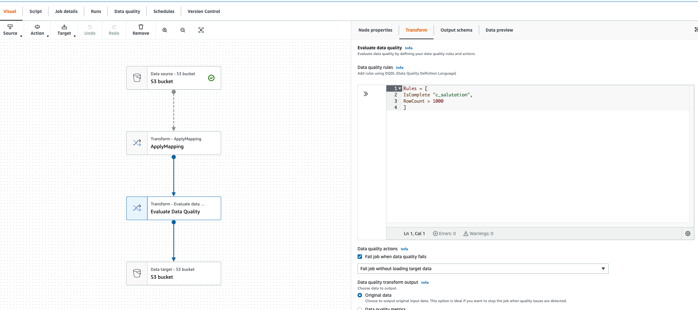

How it works: Data Quality on AWS Glue ETL Pipelines
Preview
Data Engineer
Selects an ETL Job and adds Data Quality rules
AWS Glue Data Quality Evaluates rules
Engineer reviews results and alerts, take appropriate action
Notes:
Data Engineers use AWS Glue Studio to build their pipelines. Now, if you are a data engineer who create visual jobs, you can add a Evaluate Data Quality transform in your data pipeline. You can add new data quality rules and associate actions – for instance you may want to stop the job the moment you encounter bad records. Then you just run your pipelines. The data quality metrics are stored in the Data Quality Tab. You have the option to write data quality results to S3 and query them.
AWS Glue Studio is our job authoring UI, and it provides ETL interfaces for all your users, regardless of skillset.
Data engineers, IT/data professionals, and Line-of-business analysts all have a part to play in the process of moving data and preparing it for analysis.
Their skills span the range from Visual tools to SQL to Scala.
TRANSITION:
Let’s take a tour through the authoring tools that we provide to support them.

Slide 27
PREVIEW
Scale existing Python code in AWS Glue with Ray
No infrastructure management or tuning
Cost-effective to scale with pay-as-you-go billing
AWS Glue
for Ray
Easy to scale Ray open source Python framework, made serverless
Notes:
Python tops the charts as the world’s most popular programming language. Developers love Python because it is easy to use and it has a rich collection of built-in code libraries, including Pandas for data manipulation, NumPy for mathematics, and Scikit-learn for machine learning that reduce the need to write code from scratch.
But, Python is hard to scale. Data analysts and engineers often struggle to scale Python jobs to operate on thousands of disparate files at once or on large datasets. . AWS Glue for Ray is a new option for running Python code in AWS Glue that makes it easy for data analysts and engineers scale their existing native Python code to process data at any scale. It’s a serverless deployment of a new open source framework for distributing Python, called Ray. Ray automates the work of scaling Python code. It can auto scale in seconds based on the load.
Users can seamlessly load existing Python code to Glue Studio, and rapidly execute that code on data at scale. Because AWS Glue is serverless – AWS Glue with Ray can auto scale on-demand…and you never need to configure or tune any resources. And, like all Glue capabilities, you pay only for the resources you use while running code.
AWS Glue for Ray includes Ray-enabled versions of the popular Python data processing libraries that you already use. It also integrates with other AWS services to simplify secure access to data in data lakes, data warehouses, and traditional data stores.

Slide 28
AWS Glue for Ray
Preview
Scalable to hundreds of nodes
Superfast start and scale up/down time
Familiar Python Primitives, built-in libraries
Notes:
For distributed processing, useful for large dataset, Glue offers Spark based engine. Glue also offers a single-node Python engine for small dataset. Developers using Python engine loves the easy setup and ability to install their custom Python libraries. We are happy to announce that now Python developers can scale their data integration applications (written in Python) using Ray engine.

Slide 29


How it works: AWS Glue for Ray
Preview
Ray Worker
Serverless environment
Automatic scale up and scale down
Support batch and interactive workloads
Jobs start in few seconds and scale up and down in few seconds.
Customize the environment by using your own libraries and modules
Author jobs using Sagemaker Studio Notebook or your own local notebook
Ray Worker
Ray Worker
Ray Worker
Notes:
We were awesome: Glue offers a single-node serverless python engine that comes with built-in data integration libraries like AWSWrangler, Numpy, Pandas, Scikit-learn, and scipy. It also include AWS tools like boto3 and connectors for popular data sources like redshift, jdbc, elasticsearch, and support for data formats like AVRO, orc. You can customize this data integration engine by bringing in your own libraries. Customers use this when they need to process small data set or dataset that can broken into chunks for single-node processing.

Slide 30
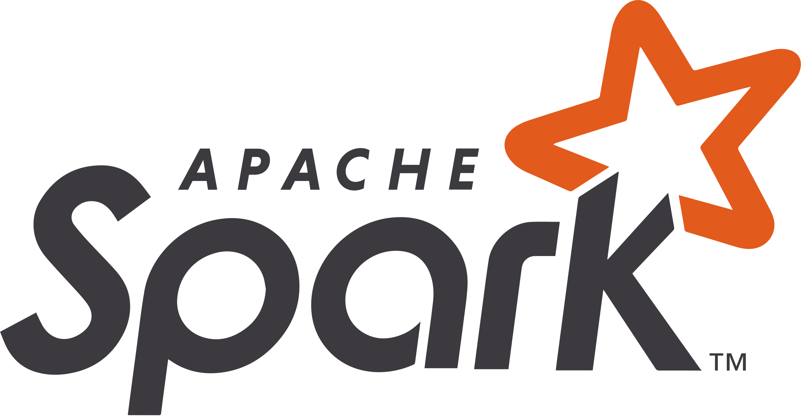



Glue 4.0
New
Fast, predictable, and cost-effective
Adds more options for scaling, storing, and running your jobs
Upgrades Glue engines
Apache Spark 3.3.0
Python 3.10
Scala 2.12
Performance optimized Spark 3.3
Distributed Pandas API on Spark -
Improved data processing
Amazon Redshift integration
Apache Spark – 10x faster in TPC-DS at 3TB scale
Notes:
We’re pleased to announce the launch of AWS Glue version 4.0, the newest version of AWS Glue for batch jobs that accelerates data integration workloads in AWS.
It will upgrade the the Spark engines to the latest version of Apache Spark 3.3.0, Python 3.10. Glue 4.0 gives you the latest Spark and Python releases so you can develop, run, and scale your data integration workloads and get insights faster.
With Redshift integration, data engineers and scientists using Amazon EMR or Amazon SageMaker can instantly access data in Redshift with high performance and transactional consistency.
We are seeing queries running up to 10X faster in TPC-DS benchmark at 3TB scale.
TRANSITION: We offer more than one data integration engines

Slide 31

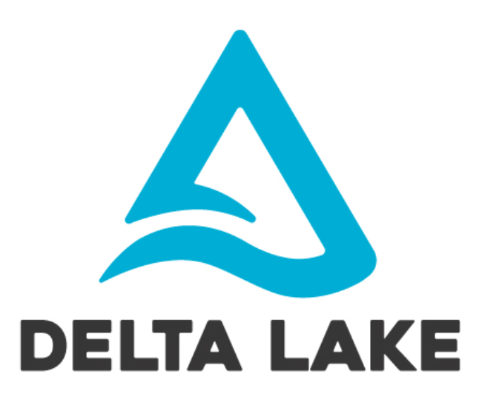

Native support for Hudi, Delta, and Iceberg
New
Apache Hudi | Delta Lake | Apache Iceberg
Built in support to read and write (insert, update and delete)
No setup, minimal configuration and easy to deploy
Latest framework versions available with Glue v4.0
Simplify incremental data processing in data lakes built on Amazon S3
Notes:
This feature removes the need to install a separate connector and reduces the configuration steps required to use these frameworks in AWS Glue with Apache Spark jobs.
As with all native libraries, Glue will upgrade the version periodically along with Glue versions, specifically with Glue v4.0 we now support the latest versions of :
Apache Hudi 0.12.0 Delta Lake 2.1.0 Apache Iceberg 1.0.0
We recognize that open source versions will continue to be updated next year; which means in some cases before Glue’s next version update is available, users can override built-in library versions with their own.
TRANSITION
Next section Job Authoring
[NOTE: In all regions with Glue v3.0 (Spark 3.1.1) using the following versions. Apache Hudi 0.10.1 Delta Lake 1.0.0 Apache Iceberg 0.13.1\

Slide 32
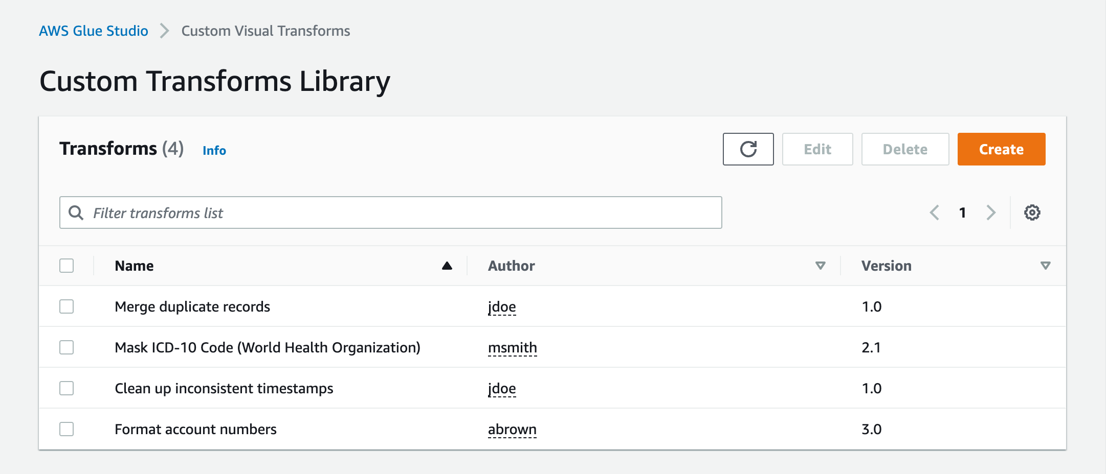
Custom visual transforms
New
(Re)use custom business logic in visual ETL jobs
Share custom transformations between teams
Benefits:
Reduces dependence on Spark developers
Maintain and update jobs more easily
Custom visual transforms work in both visual and code-based jobs
Notes:
Custom visual transform let customers define, reuse, and share business-specific ETL logic among their teams. With this new feature, data engineers can write reusable transforms for the AWS Glue visual job editor. Reusable transforms increase consistency between teams and help keep jobs up to date by minimizing duplicate effort and code.
TRANSITION:
In closing…

Slide 33
AWS Glue Studio
ETL developer
Run ETL jobs without writing code
Monitor thousands of jobs through a single pane of glass
Distributed processes
Advanced transforms through code snippets
Notes:
1/AWS Glue Studio is a new visual interface for AWS Glue that makes it easy for extract-transform-and-load (ETL) developers to author, run, and monitor AWS Glue ETL jobs.
2/You can now use a simple visual interface to compose jobs that move and transform data and run them on AWS Glue. You can then use AWS Glue Studio’s job run dashboard to monitor ETL execution and ensure that your jobs are operating as intended.
3/AWS Glue Studio makes ETL accessible to the many users who are new to Apache Spark programming and to users who are accustomed to ETL tools with boxes-and-arrows interfaces. Without writing code, users of all experience levels can now take advantage of big data processing on AWS Glue’s serverless Apache Spark-based ETL platform.
4/They can also use the AWS Glue Studio job monitoring dashboard to get a global view of their ETL execution and resource usage.

Slide 34
AWS Glue DataBrew
Business Analyst Data Scientist
Rich visual interface
250+ built-in transformations
Profile data to understand data patterns and anomalies
Work on large datasets at scale
Notes:
1/AWS Glue DataBrew makes it easy for data scientists and data analysts to clean and normalize data using a visual interface, reducing the time it takes to prepare data by up to 80%. With Glue DataBrew, you can visualize, clean, and normalize data directly from your data lake, data warehouses, and databases. You can choose from over 250 built-in transformations to automate data cleaning and normalization tasks, and save these transformation steps so they’re applied to new data as it comes in. You can evaluate the quality of your data by profiling it to understand data patterns and detect anomalies, all without writing a single line of code.
72As part of AWS Glue, Glue DataBrew is serverless so you don’t need to manage the infrastructure. You pay only for what you use, with no upfront commitment. You can check out the Glue DataBrew page on the AWS website today, and learn more from our re:Invent session “Zero-code data preparation with AWS Glue DataBrew”.
TRANSITION: Besides the business analysts and data scientists, there are also data engineers who prefer to use Glue in a different interface.

Slide 35
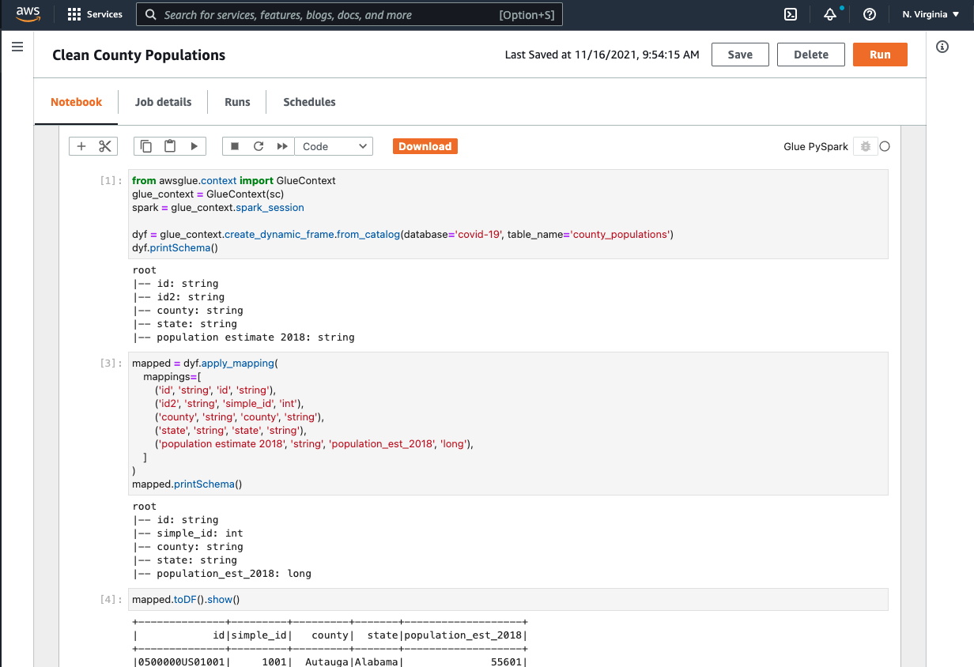
AWS Glue Notebooks
Data engineer
Clean and normalize data with a rich visual interface
Choose from 250+ built-in transformations to automate tasks
Profile data to understand data patterns and anomalies
Notes:
That’s why we built Glue Notebooks for data engineers who prefer a notebook experience allowing them to clean and normalize data with a rich visual interface.

Slide 36
Interactive Sessions and Job Notebooks
Next-generation interactive data exploration and job development
Time to first query: 10 minutes → 30 seconds
Use AWS Glue Studio or your preferred IDE or Notebook
Live serverless data integration
Ephemeral infrastructure with built-in cost controls
Dedicated resources for no noisy neighbors

Slide 37
AWS Glue Autoscaling
Setup
AWS Glue job
Tear-down
Cost = f(compute)
Wide transform
Uneven distribution of data partitions
Potential savings
List operation
Job execution timeline
Notes:
With Autoscaling, AWS Glue dynamically scales resources up and down based on your workload. During the course of a data integration job, due to variance in data size or job stage, the compute required changes. Imagine the life of a data integration job run. It starts at t1 and ends at t10. Without Autoscaling, you would specify the number of workers upfront, and AWS Glue's engine allocates the capacity for the entirety of the job run. The area in purple is the price the you pay. With Autoscaling, your job is assigned workers only when needed. As the job progresses, and it goes through advanced transforms, AWS Glue adds and removes resources depending on how much it can split up the workload. You no longer need to worry about over-provisioning resources, spend time optimizing the number of workers, or pay for idle resources. AWS Glue Autoscaling frees Data Engineers’ time, reduces compute costs and allows them to focus on deriving value out of their data. Moving data into your data lake is just the first step – the next challenge is ensuring your data engineers have the right tools to interact with that data.

Slide 38
<Slide: EC2 Intro Slide>
Define sensitive data
AWS Glue
Sensitive Data Detection
Detect sensitive data at scale
Remediate: delete, redact, replace, or report
Notes:
Businesses struggle to identify sensitive information in their data - like tax ID numbers, names, and medical information. Finding sensitive data in data lakes is like finding a needle in an increasingly large haystack. First, your data volume is always increasing. Next, sensitive data can be found anywhere. Finally, it’s hard. We need to build high fidelity techniques to detect all types of sensitive data in the pipeline and in the data lake. To help you define, detect, and process sensitive data, we are announcing the General Availability of Sensitive Data Detection in AWS Glue. AWS Glue Sensitive Data Detection can identify sensitive data while it’s still in your data pipeline, so you can prevent that data from landing in your data lake. It can also pinpoint the locations of sensitive data already IN your data lake, so you can delete, redact, replace, or report on that data. It works at scale - and is serverless - so Sensitive Data Detection has never been easier or more cost-effective.

